Slide 1
Dengue in Bangladesh
Tableau visualization project that attempts to connect Dengue cases in Bangladesh with the weather and levels of rainfall experienced.
Tableau Public Link for the entire Workbook.

Slide 2
Background
Dengue is a vector borne illness- Mosquitos
Hospitalizations in Bangladesh are occurring to this day.
Hot bed for vector borne illness because of weather
How does the weather affect disease levels in the country?
How is the public fighting against the vectors?
In addition to diseases: supply shortage and political/religious persecution.
Rohingya group are fleeing Myanmar and are coming into Bangladesh

Slide 3
Datasets
Number of cases from IEDCR along with weather records from the Meteorological Department.
Weather prediction model for the country starting from 1970.
Burden of dengue in Bangladesh- scientific study.
Notes:
IEDCR- The Institute of Epidemiology, Disease Control And Research
Kaggle
Kaggle. Not a lot of information is known about this dataset
Scientific paper published in Epidemiology and Global Health.

Slide 4
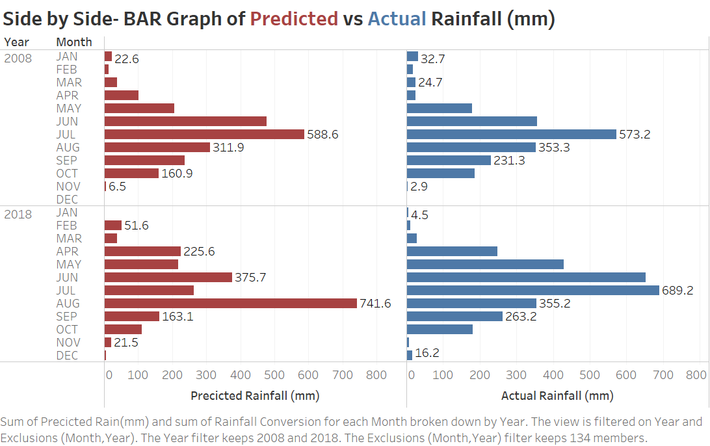
Visualization 1
Notes:
Dashboard

Slide 5
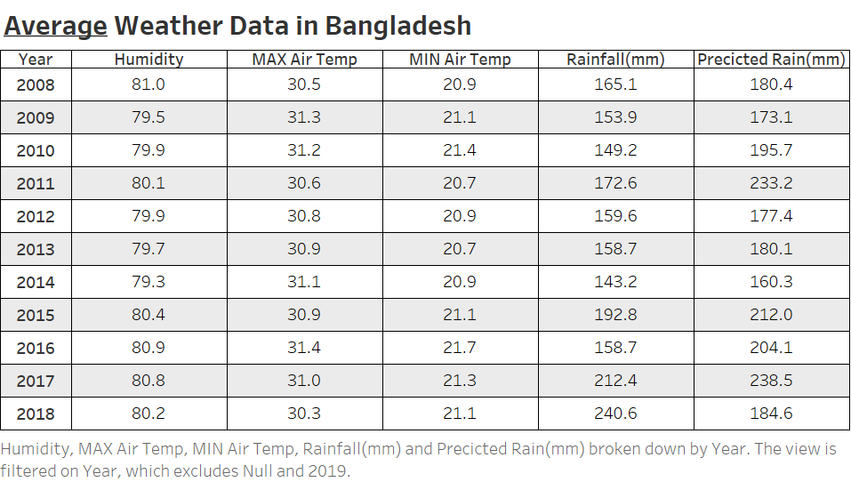
Visualization 2
Notes:
Dashboard

Slide 6
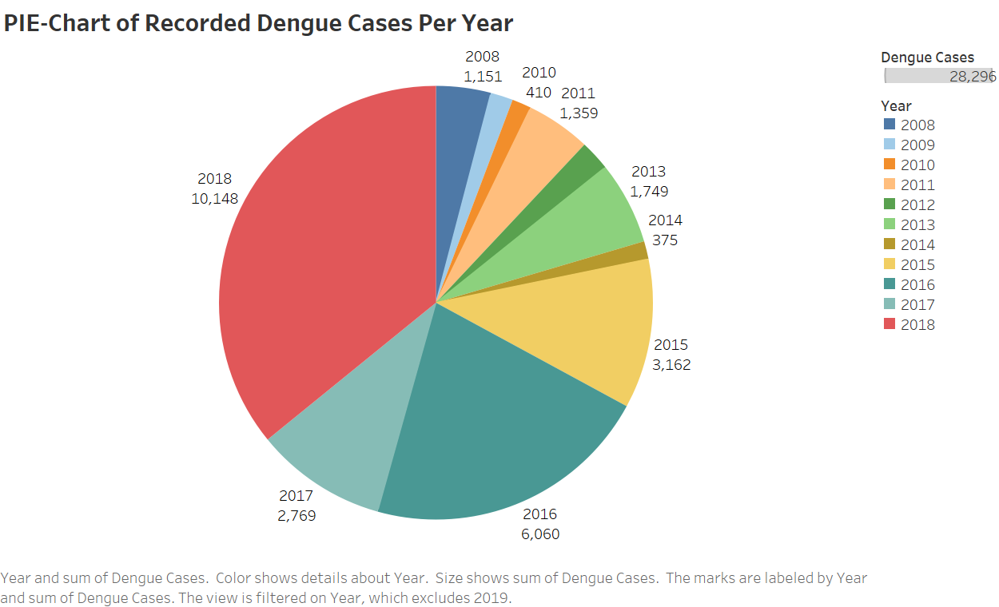
Visualization 3

Slide 7
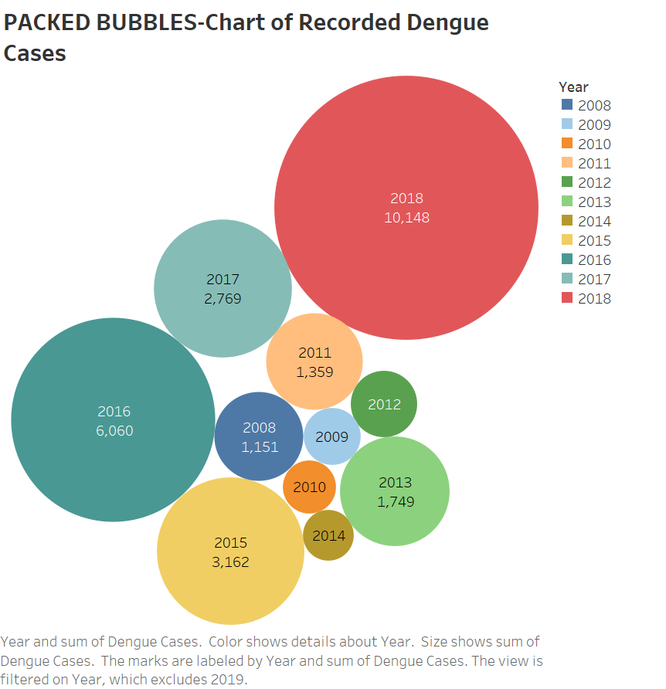
Visualization 3(B)

Slide 8
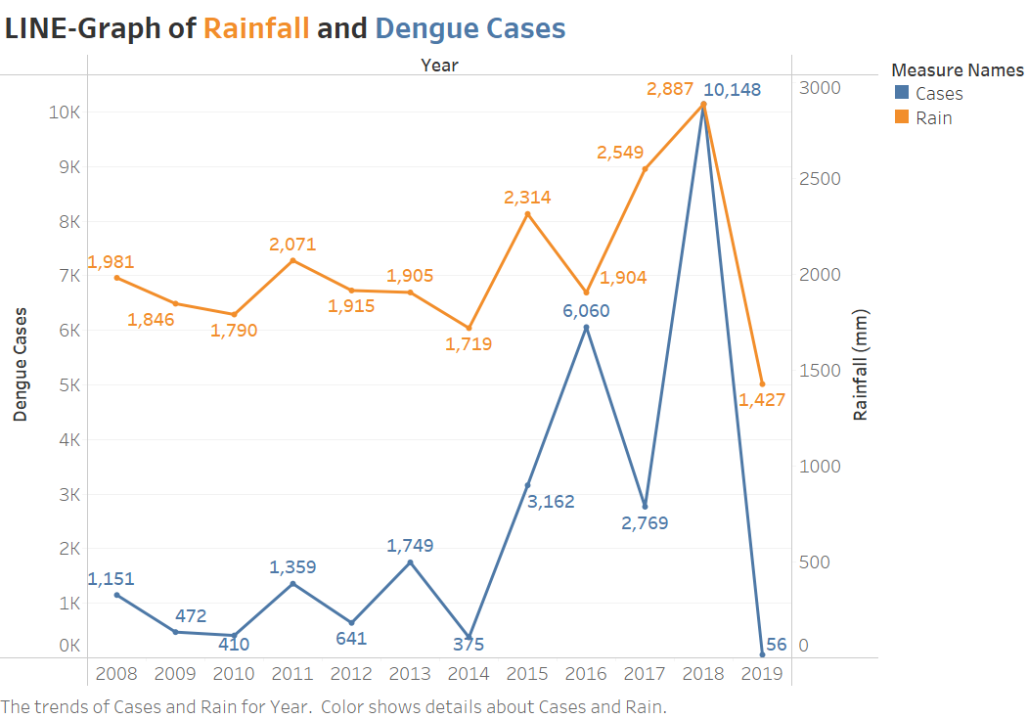
Visualization 4

Slide 9
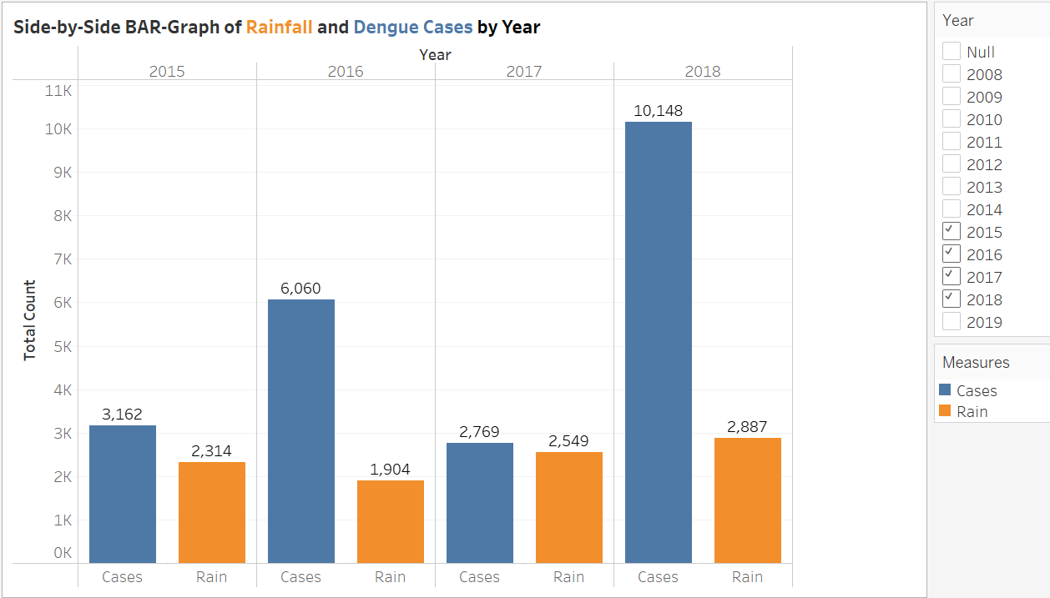
Visualization 5
Notes:
Dashboard

Slide 10
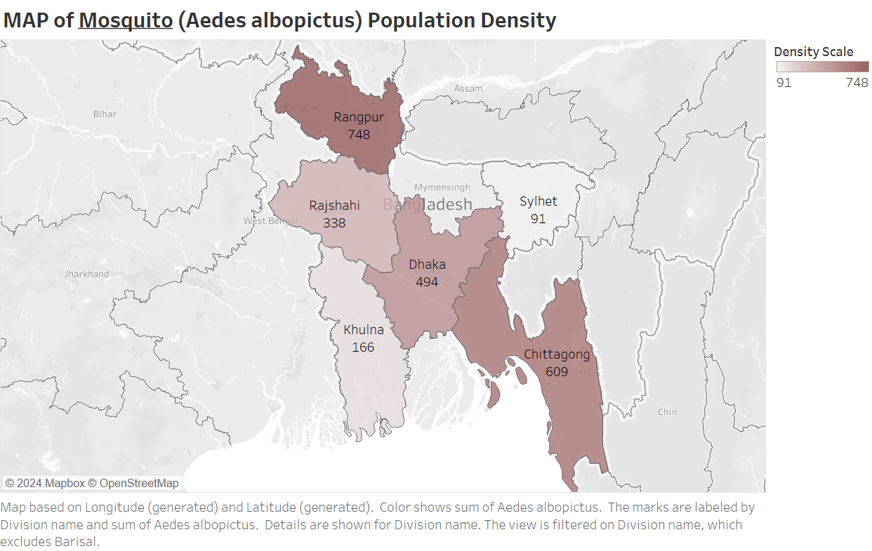
Visualization 6

Slide 11
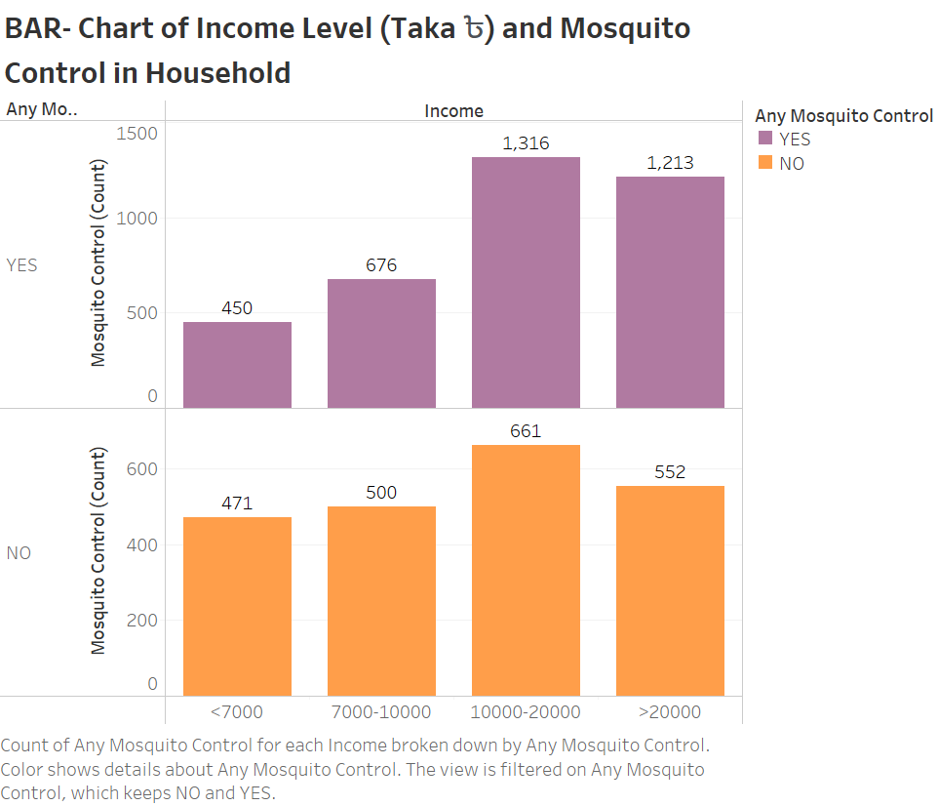
Visualization 7

Slide 12
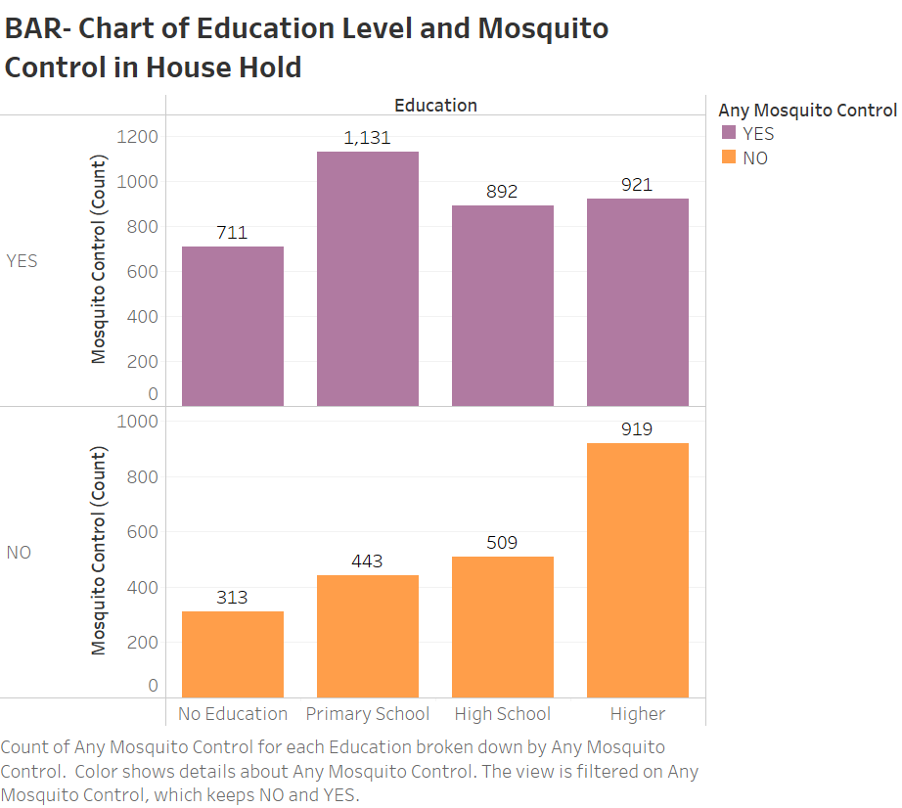
Visualization 8

Slide 13
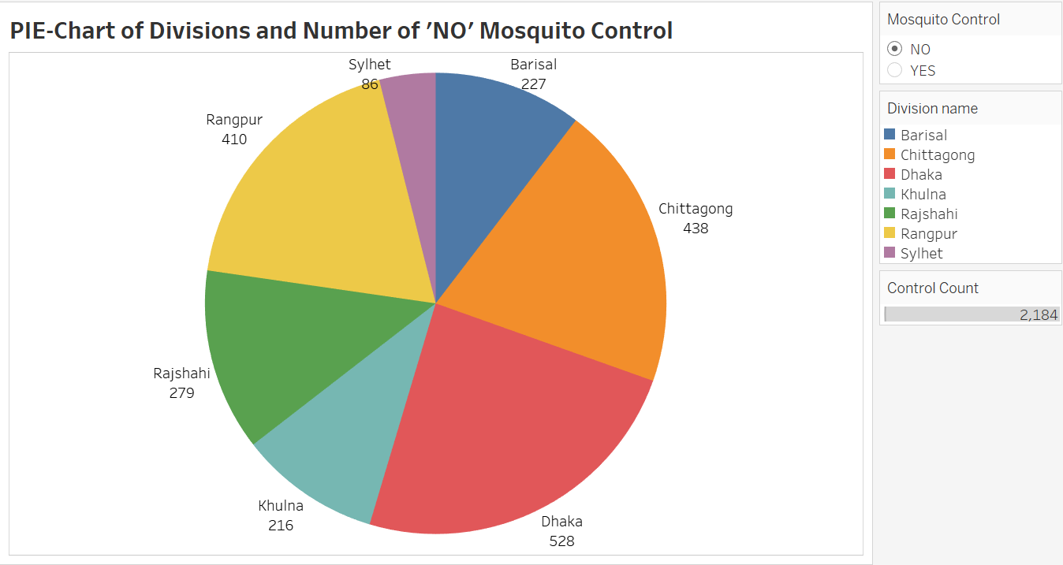
Visualization 9

Slide 14
Summary
Visualization studies like this helps countries like Bangladesh.
It helps:
Policy makers in the government
City Planners working on public infrastructure
Public Health efforts by government groups and local groups
Public education and awareness

Slide 15
Reference
Syed, S. (2022, October 19). Dengue death toll tops 100 in Bangladesh. Dhaka Tribune. https://www.dhakatribune.com/bangladesh/2022/10/19/dengue-death-toll-tops-100-in-bangladesh
World Health Organization. (2022, August 3). Dengue in Rohingya refugee/forcibly displaced Myanmar Nationals (FDMN) camps in Cox's Bazar - Bangladesh. World Health Organization. Retrieved October 6, 2022, from https://www.who.int/emergencies/disease-outbreak-news/item/2022-DON401
Paul, K.K., Macadam, I., Green, D., Regan, D.G., & Gray, R.T. (2021). Dengue transmission risk in a changing climate: Bangladesh could experience a longer dengue fever season in the future. Environmental Research Letters. https://doi.org/10.1101/2021.05.24.443300
Kaggle: TORIQUL ISLAM. (2022). Bangladesh Weather Prediction. Retrieved October 6, 2022, from https://www.kaggle.com/datasets/toriqulislam/bangladesh-weather-prediction
Kaggle: FAZLY RABBI. (2022). Dengue Incidents and Weather Data of Bangladesh Retrieved October 6, 2022, from https://www.kaggle.com/datasets/fazlyrabbi/dengue-incidents-weather-of-bangladesh
Salje, H., Paul, K.K., Repon P., Rodriguez-Barraquer, I., Rahman, Z., Alam, M.S., Rahman, M., Al-Amin, H.M., Heffelfinger, J., & Gurley, E. (2019). Nationally-representative serostudy of dengue in Bangladesh allows generalizable disease burden estimates. Epidemiology and Global Health. https://doi.org/10.7554/eLife.42869

